Slide 1


Action

Slide 2


Adventure

Slide 3


Comedy

Slide 4
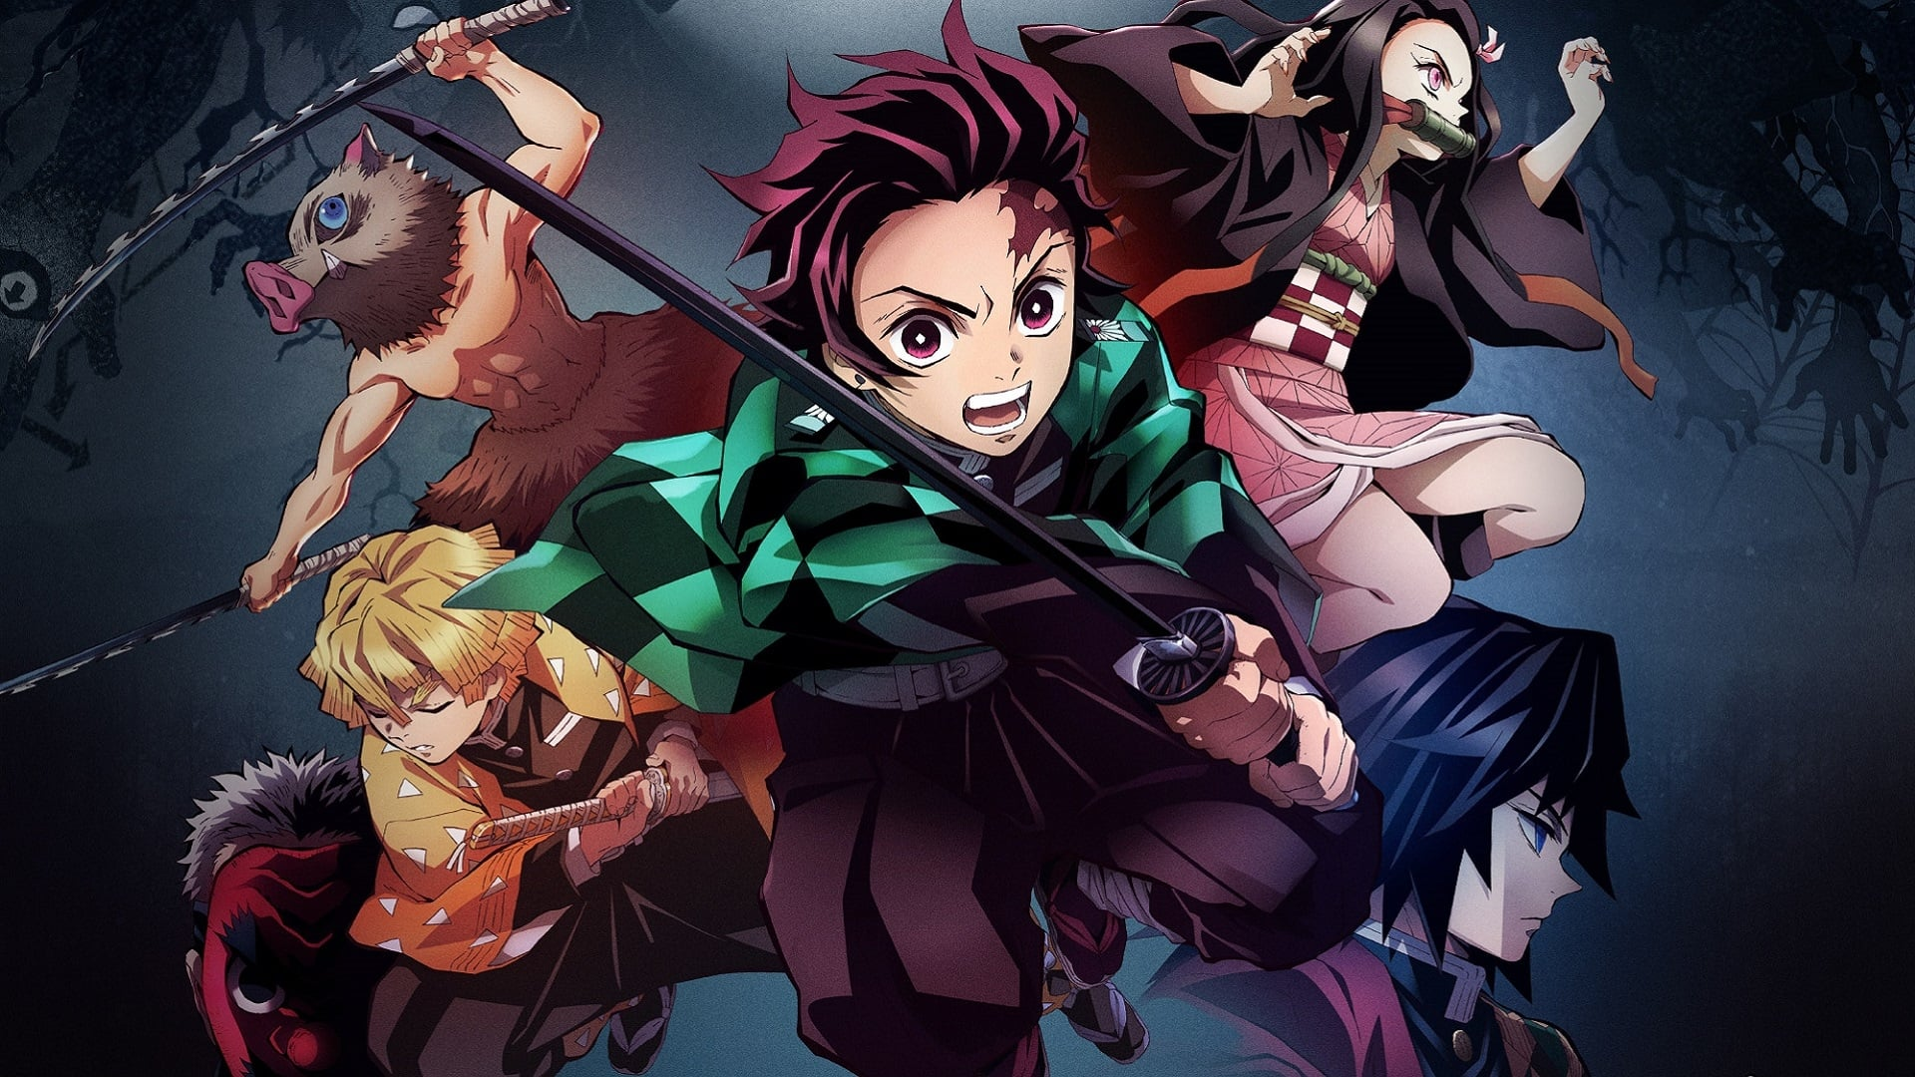

Demons

Slide 5


Drama

Slide 6
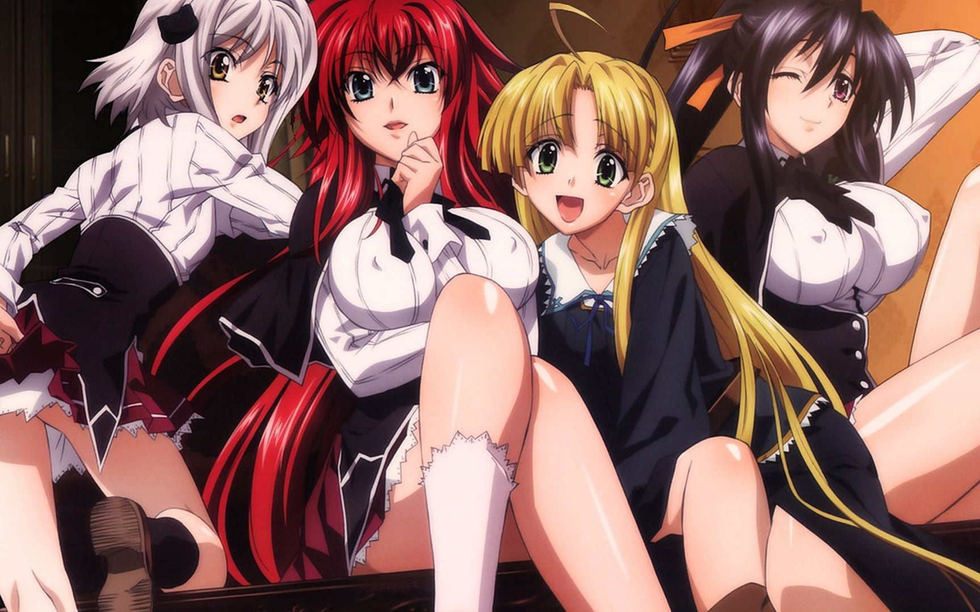

Ecchi

Slide 7


Fantasy

Slide 8


Gaming

Slide 9


Harem

Slide 10
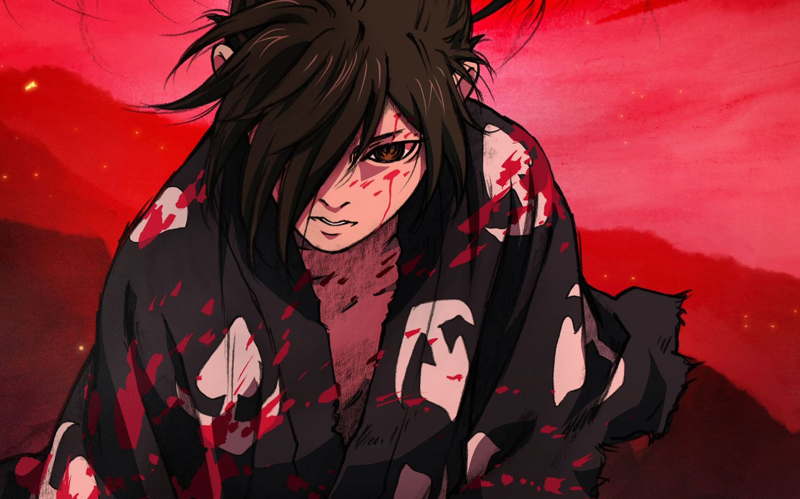

Historical

Slide 11
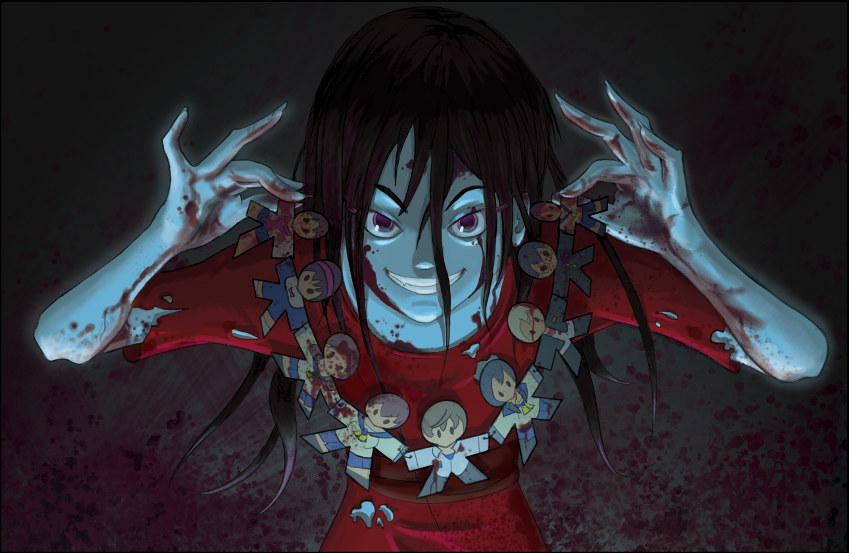

Horror

Slide 12
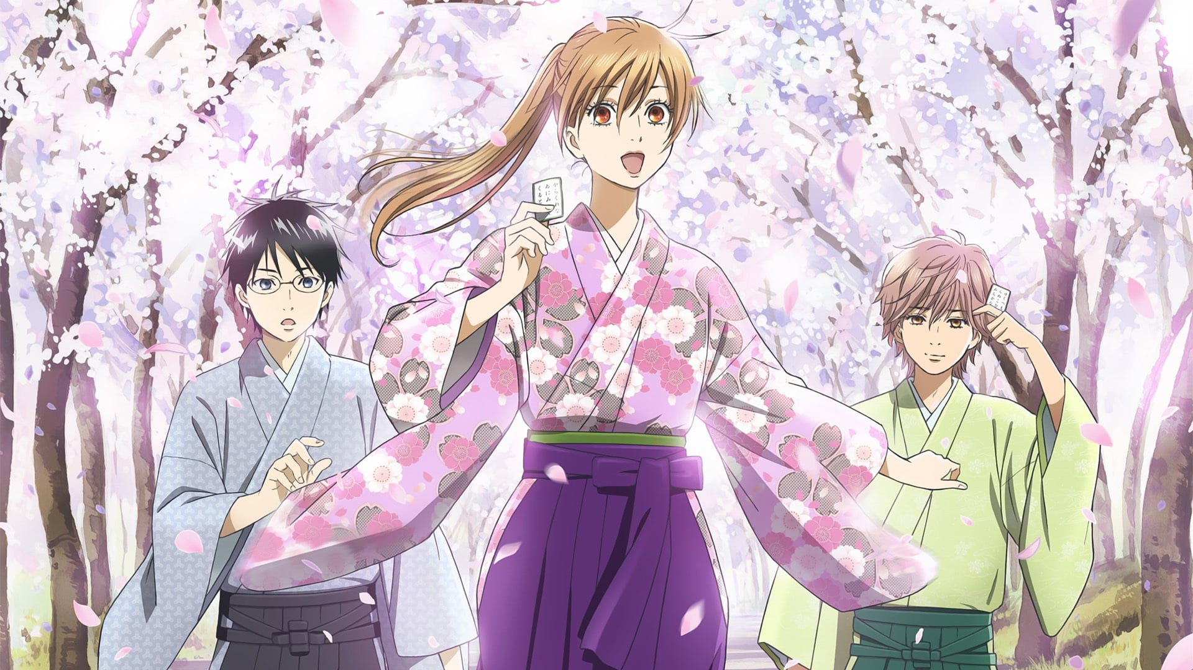

Joshi

Slide 13
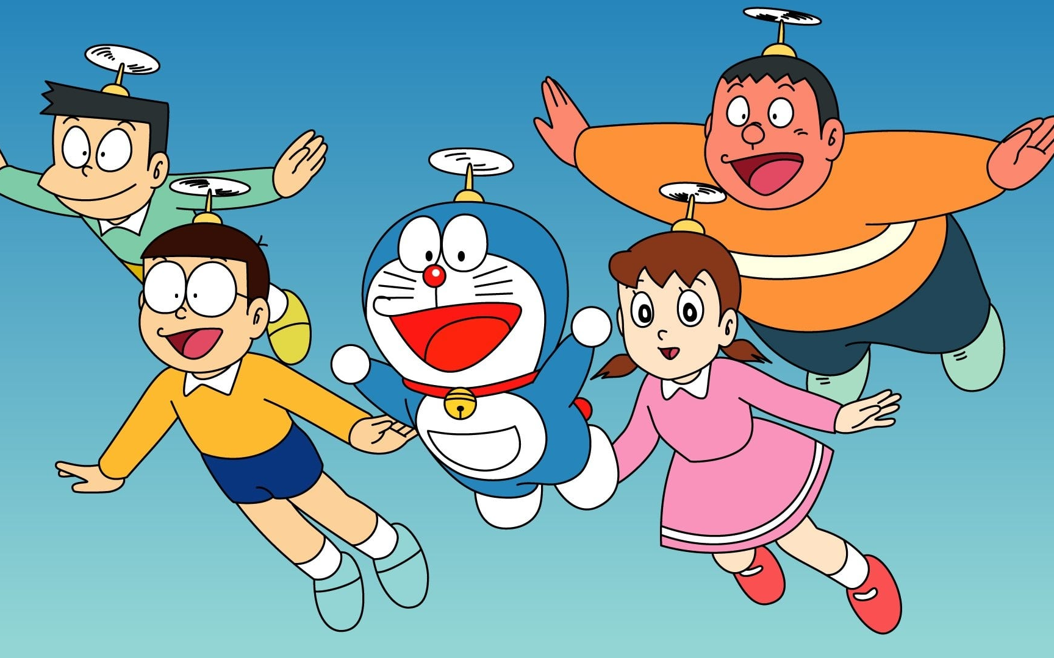

Kids

Slide 14


Magic

Slide 15
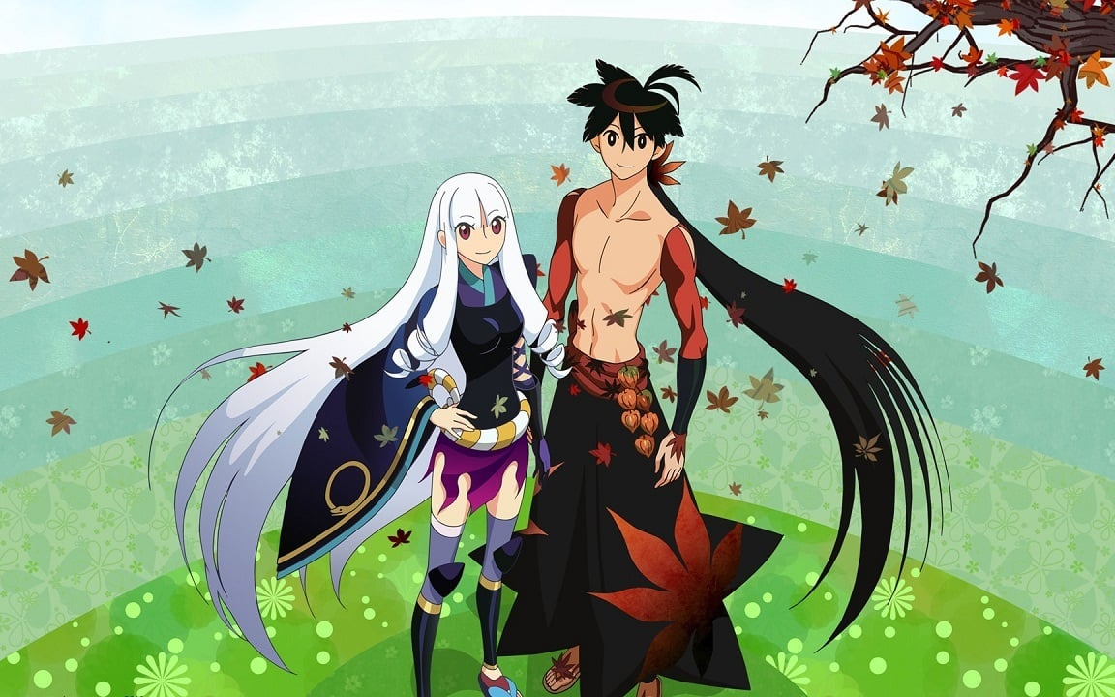

Martial Art

Slide 16


Mecha

Slide 17
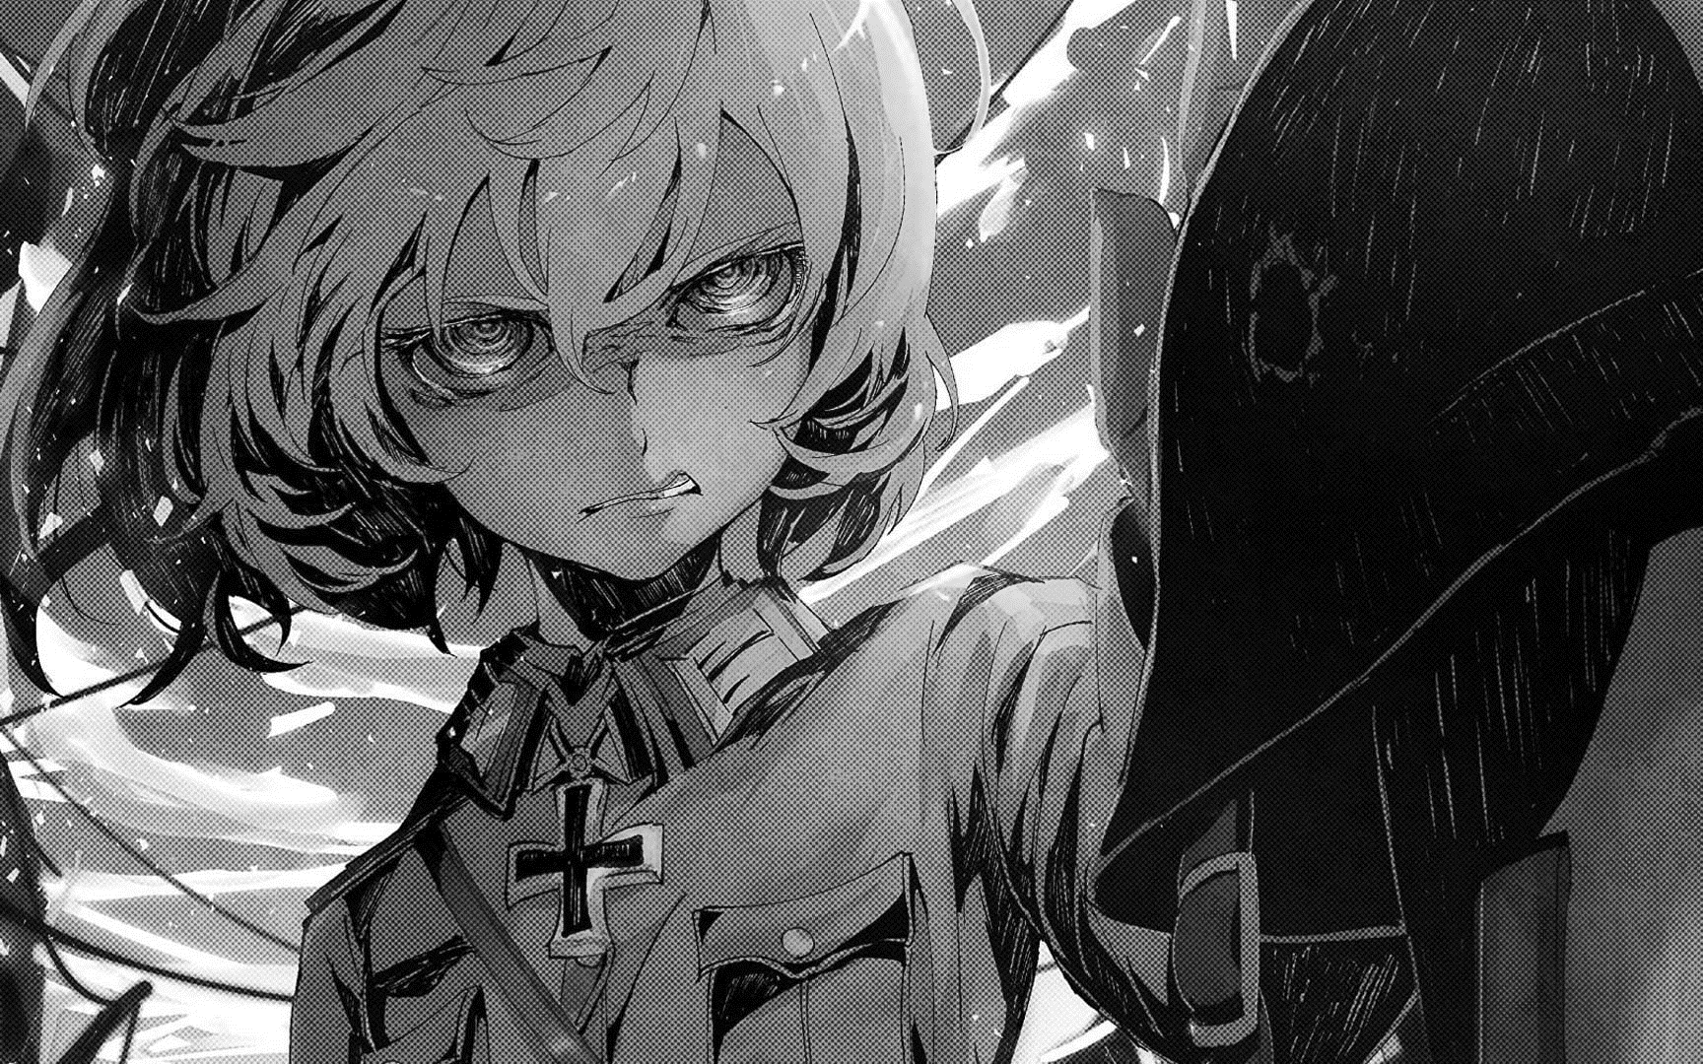

Military

Slide 18


Music

Slide 19
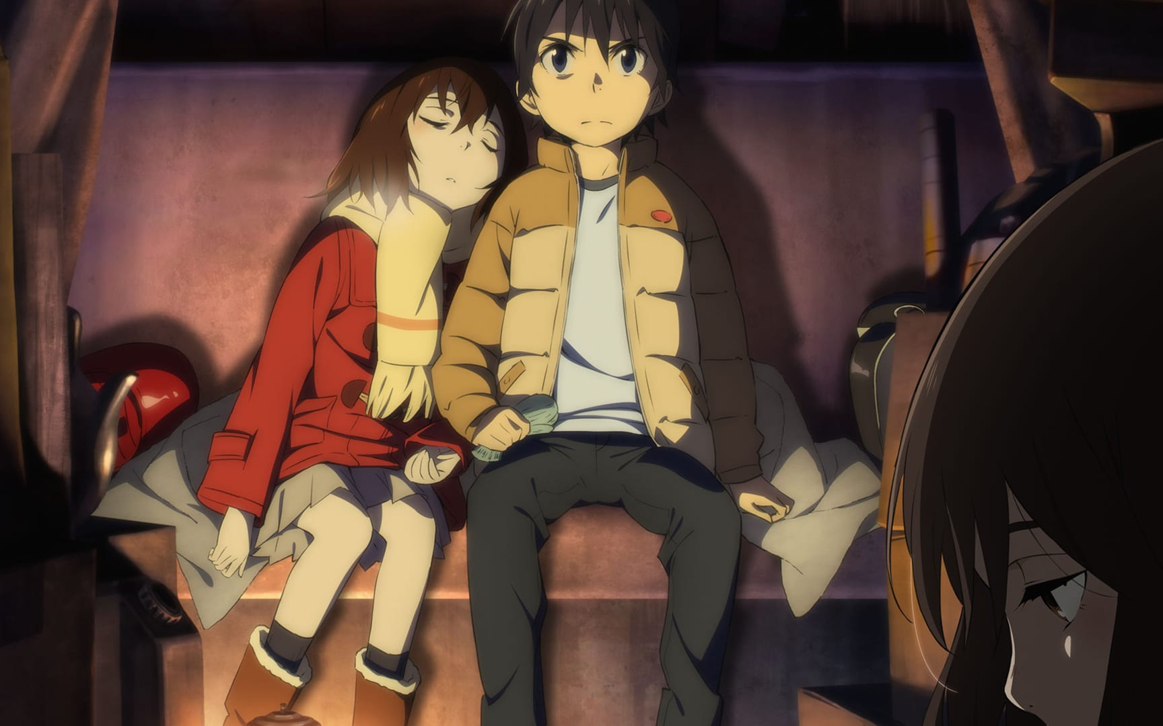

Mystery

Slide 20


Parody

Slide 21
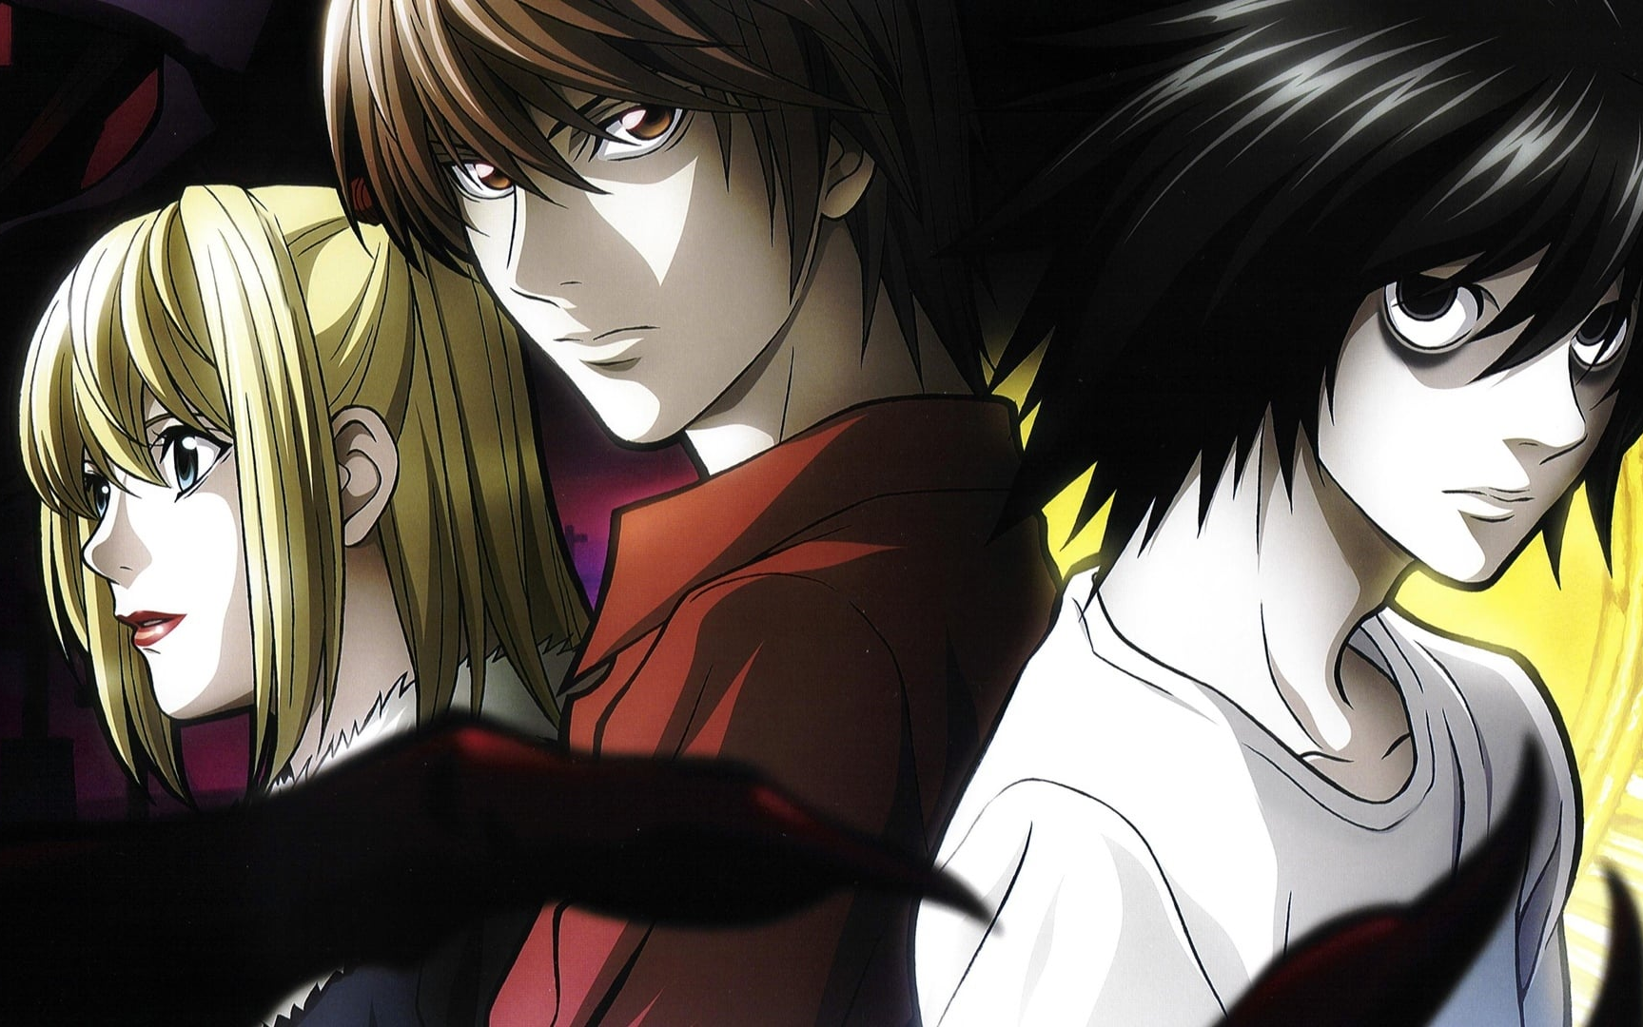

Police

Slide 22
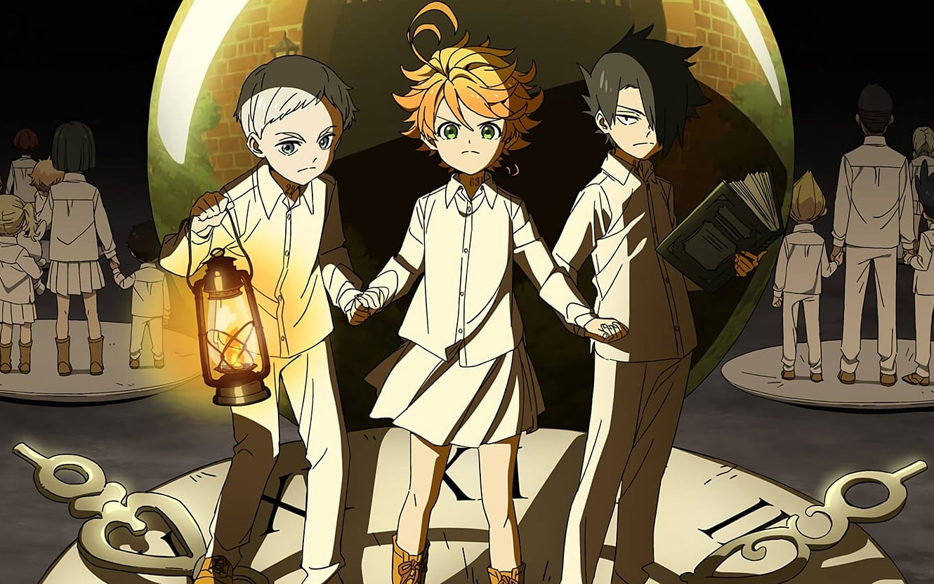

Psychological

Slide 23
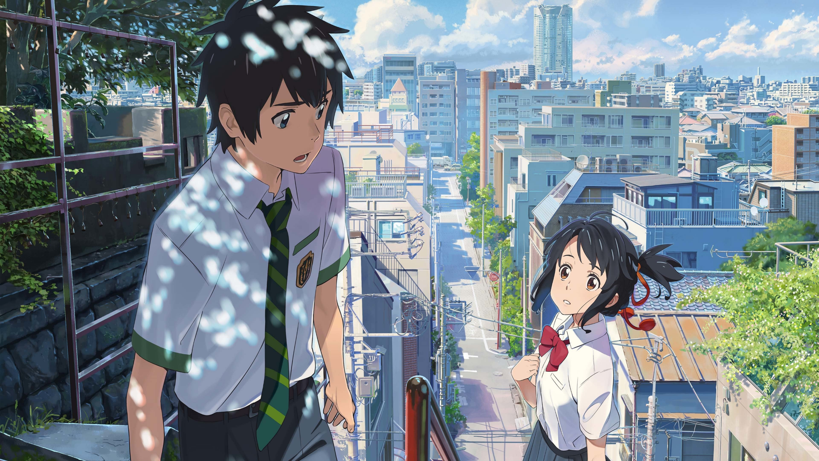

Romance

Slide 24
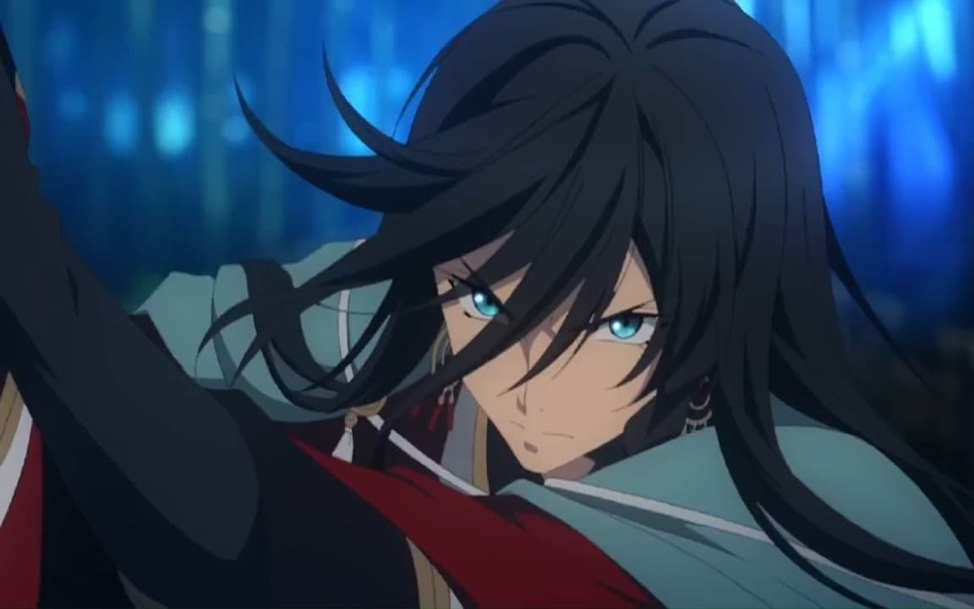

Samurai

Slide 25
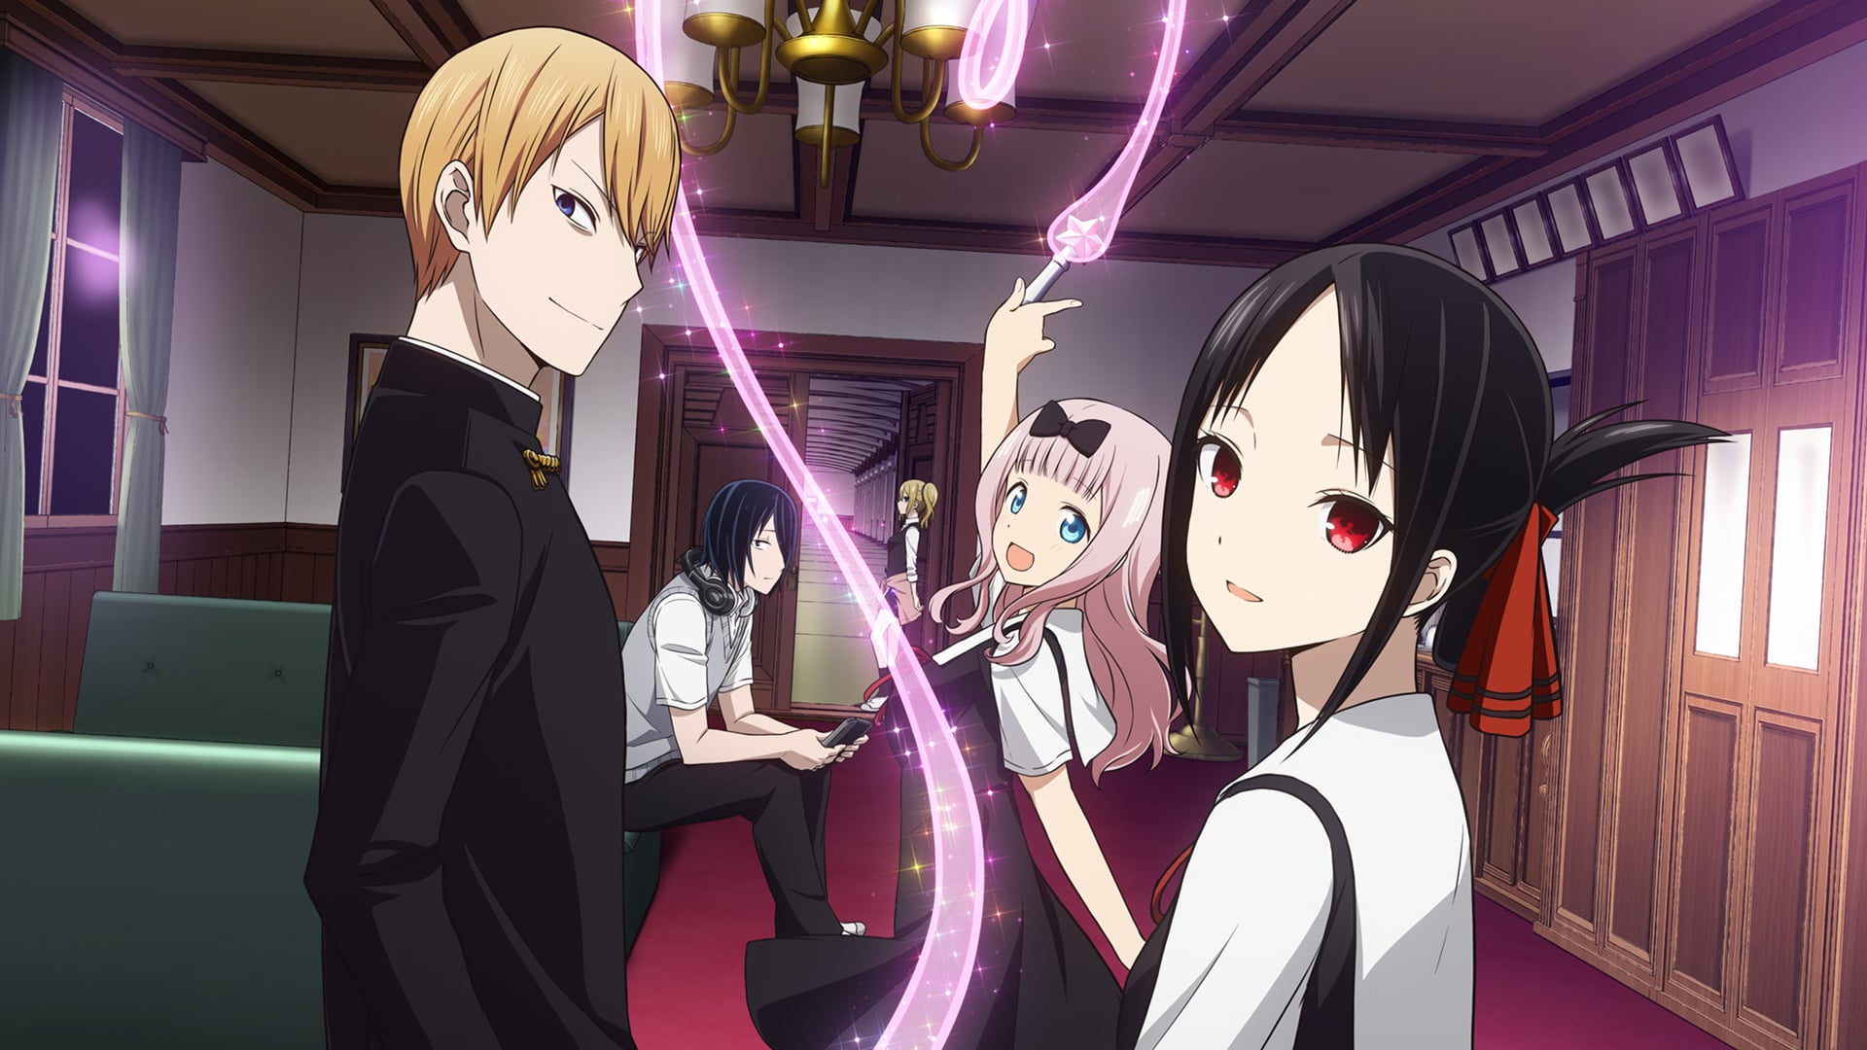

School

Slide 26


Science Fiction

Slide 27
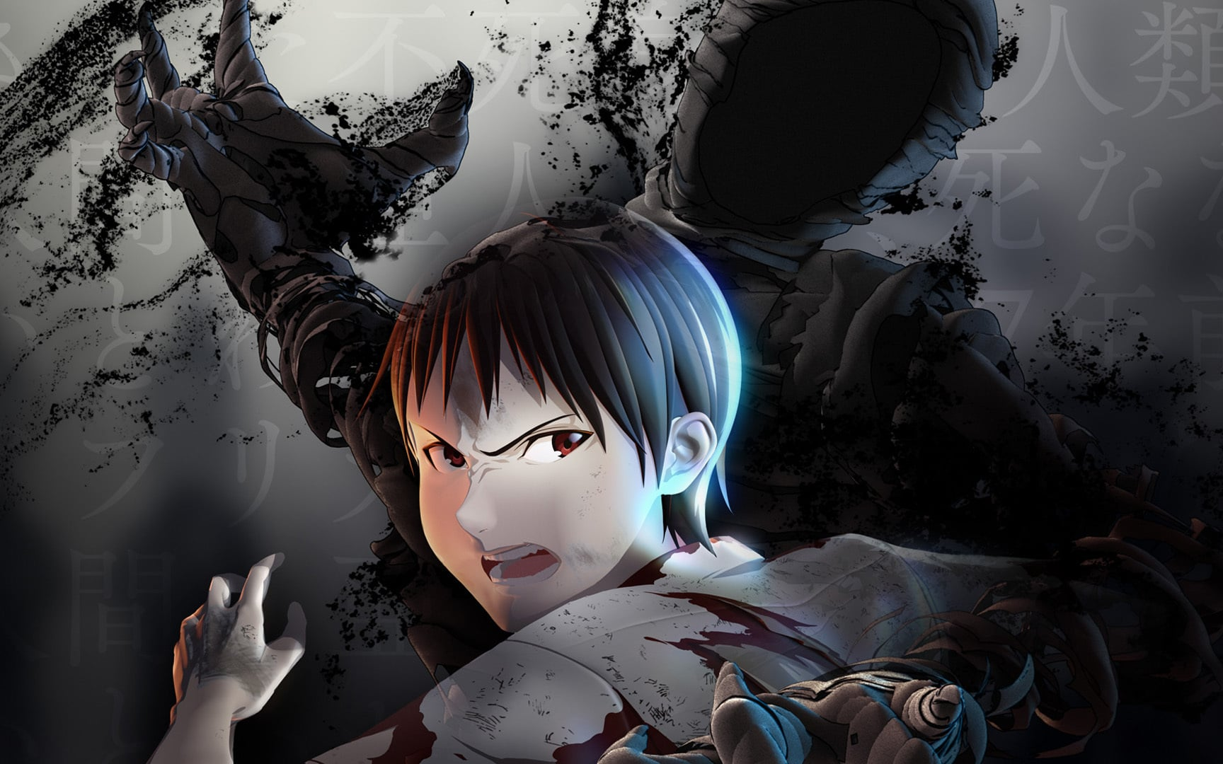

Seinen

Slide 28


Shoujo

Slide 29


Shoujo-Ai

Slide 30


Shounen

Slide 31


Shounen-Ai

Slide 32
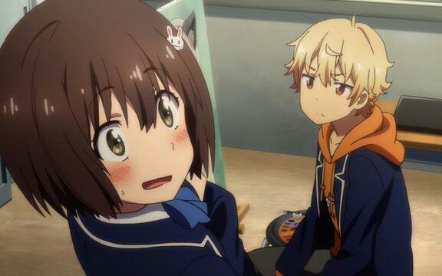

Slice of Life

Slide 33


Space

Slide 34


Sport

Slide 35


Super Power

Slide 36
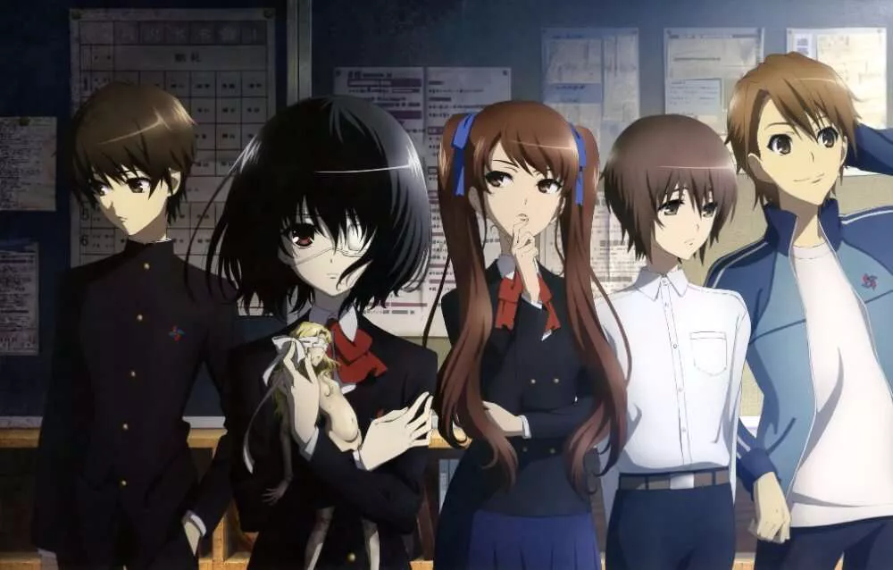

Supernatural

Slide 37


Thriller

Slide 38
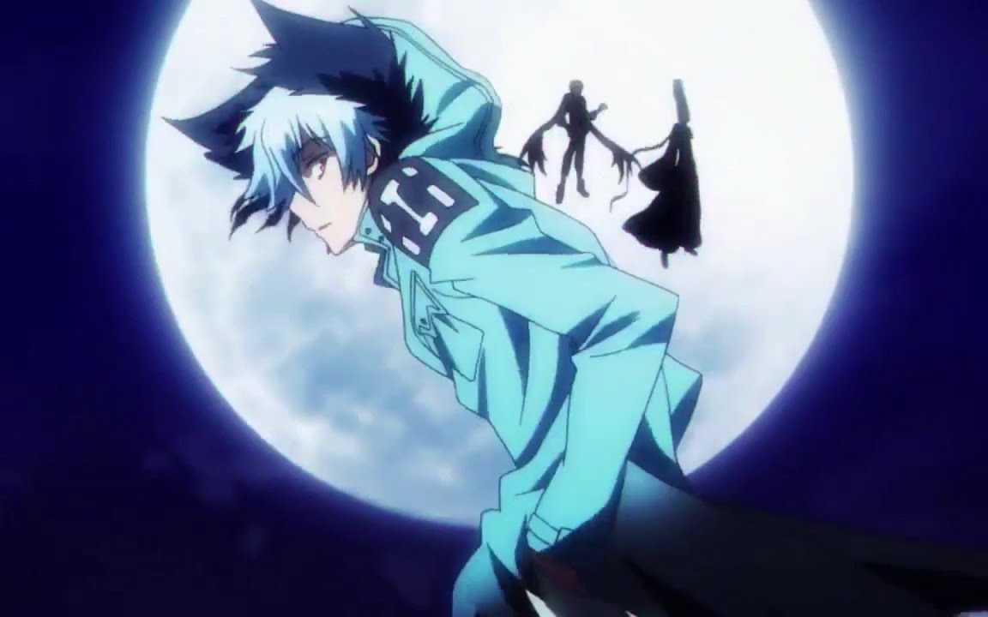

Vampire

Slide 39
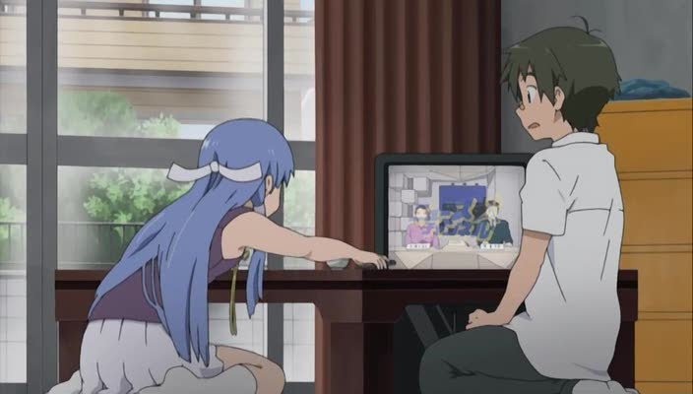

TV

Slide 40


ONA

Slide 41
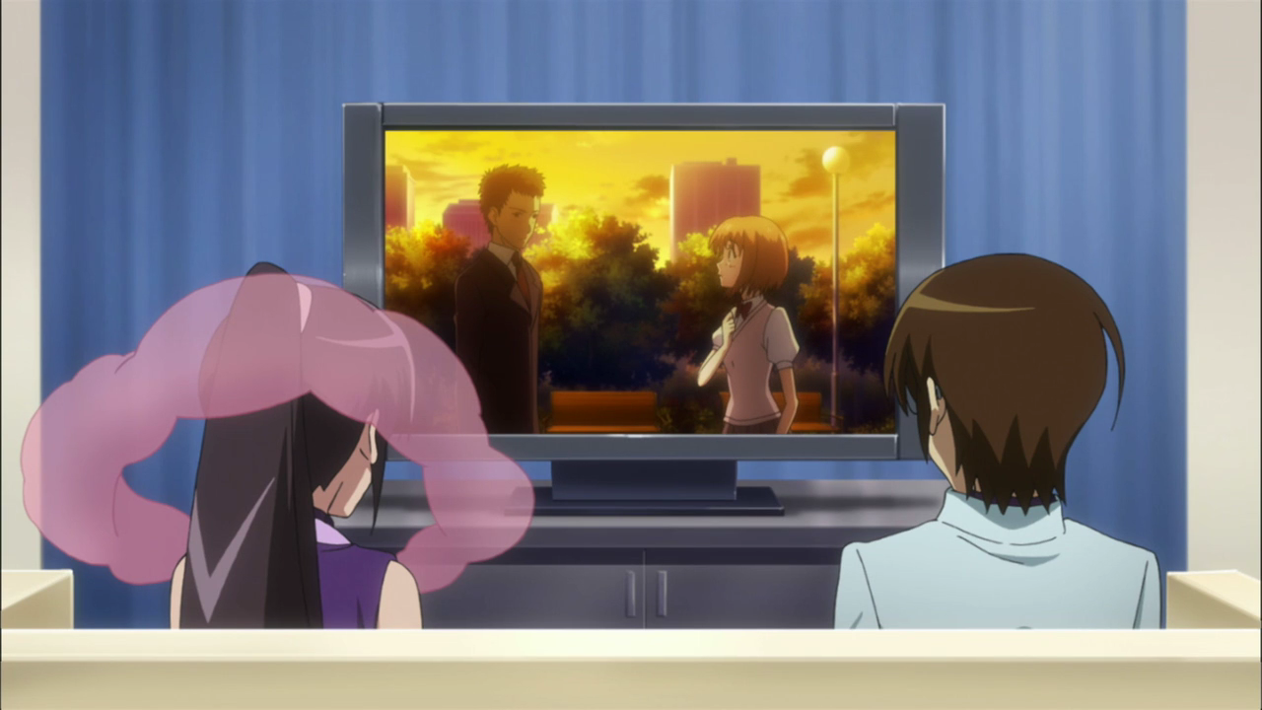

OVA

Slide 42


Special

Slide 43


Film

Slide 44
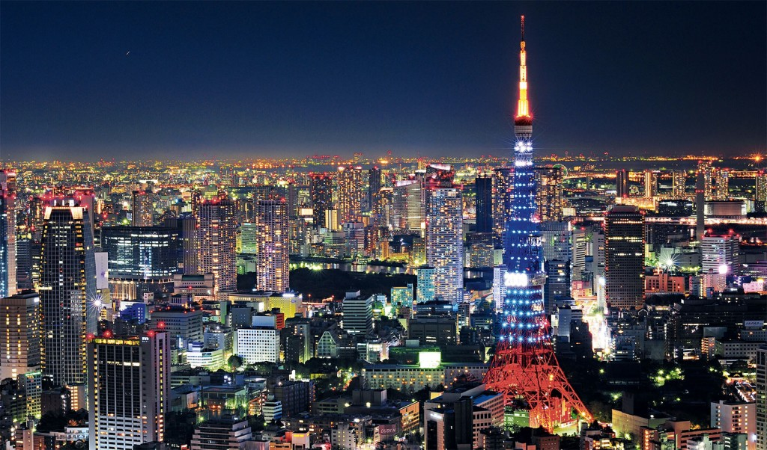

Jepang

Slide 45


China

Slide 46


Korea

Slide 47


Indonesia

Slide 48


Amerika

